Slide 1
Software Development 3
Environment Variables

Slide 2
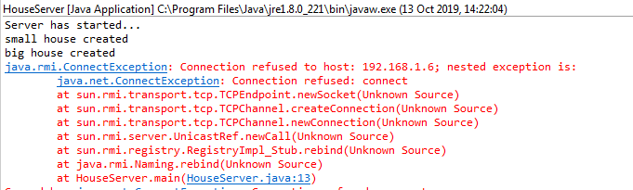
Running the RMI Application
After creating the server code, we compile it by pressing play.
This error is because the rmiregistry has not started yet….

Slide 3
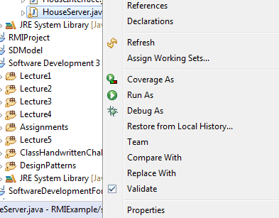
Running the RMI Application
To fix this we use the cmd/terminal
cd (Change directory) into the bin file
To find it, right click the name of the server class and go into properties:

Slide 4
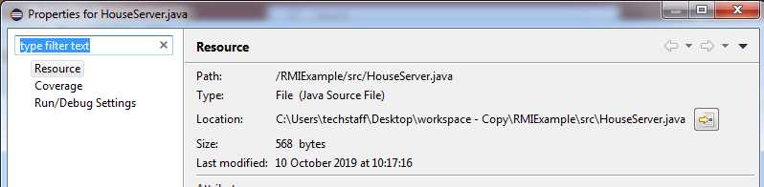
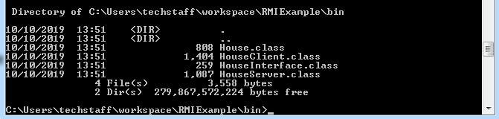
Running the RMI Application
The address you need is under location:

Slide 5
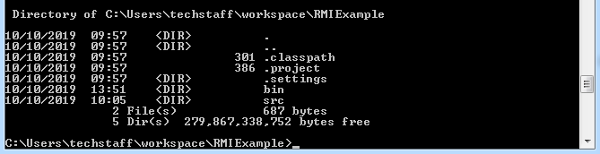
Running the RMI Application
Please note the difference:
  Instead of going into src, we go into the bin file inside the project:

Slide 6

Running the RMI Application
The next (possible) problem, is that we need to start the rmiregister and when we run
  rmic House
  This means we need to include the jdk to the path
  Environment Variables!!!!

Slide 7
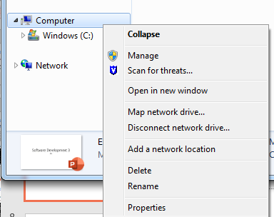
Running the RMI Application
To do this, find a folder where you can right click MyPC or MyComputer depending on your operating system
Click Properties

Slide 8
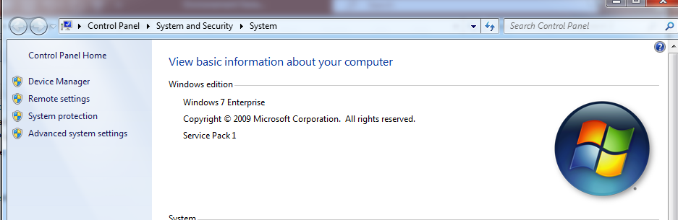
Running the RMI Application
Here we need Advanced System Settings

Slide 9
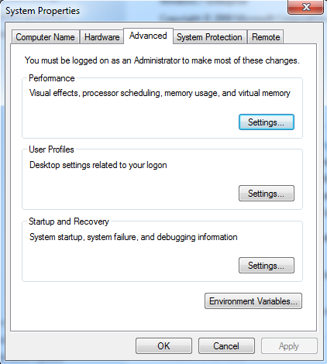
Running the RMI Application
Then we have Environment Variables

Slide 10
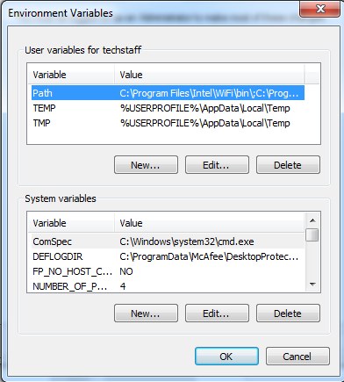
Running the RMI Application
The problem we had in class is we need to change the system variables:

Slide 11
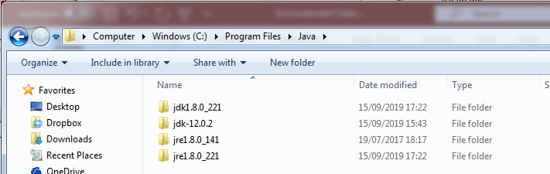
Running the RMI Application
We need to know where our JDK is stored…..
It’s normally in the following folder:
C:\Computer\Program Files\Java\jdkx.x.x

Slide 12
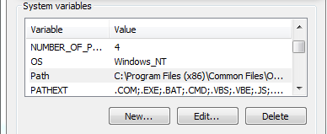
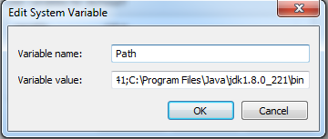
Running the RMI Application
The path is what we want to edit
At the end of what’s currently there, add a ; and type in the address ending with bin
Don’t add a semicolon at the end!
Press ok

Slide 13
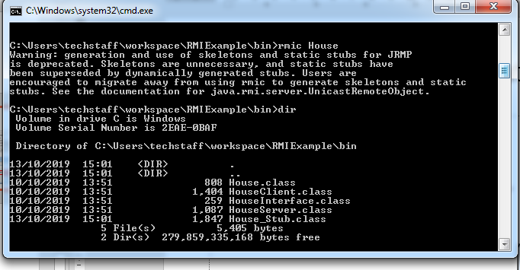
Running the RMI Application
This should now work: (you may have to exit and reopen cmd) and checking what’s in the folder (dir) you should now have House_Stub

Slide 14

Running the RMI Application
Type
  start rmiregistry
And a new window should now open
When we now go back to our server and press play:

Slide 15
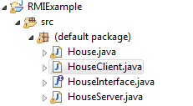
Running the RMI Application
We now go to run the client side:
If we have all the code in the same folder, it should run perfectly
I know I said to put it in separate folders, but it’s easier in one….

Slide 16
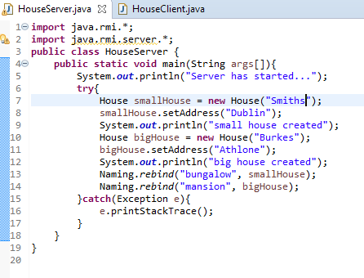
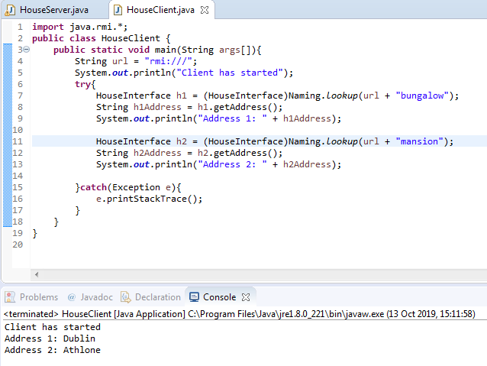
Output:

